Slide 1
EduHub – MongoDB Backend for E-Learning Platform
AltSchool- Data Engineering
Ayobami Owolabi

Slide 2
Objective of the Project
Designed a fully functional MongoDB-based backend for an e-learning platform that manages:
Users
Courses
Enrollments
Assignments
Assignment submission and
Analytics.
Tools used:
MongoDB compass,
PyMongo
Python
Jupyter Notebook

Slide 3
DATABASE Design
Collection Created:
users – Students and instructors
courses – Course information
enrollments – Student course enrollments
lessons – Individual lessons within courses
assignments – Course assignments
submissions – Student assignment submissions
users
enrollments
courses ------ lessons
assignments
submissions
Relationships between collections are designed using embedded references or manual joins via shared fields (e.g., studentId, courseId).

Slide 4
Key features
EduHub supports core features essential for a modern e-learning platform, built with MongoDB’s flexible schema and powerful query capabilities. Such as:
User Registration: Secure sign-up and login for students and instructors
Course Creation & Search: Instructors can publish courses; students can search by title, category, or tags.
Enrollments with Progress Tracking: Track student enrollment status, lesson completion, and overall progress.
Assignment Submissions & Grading: Students submit work; instructors review, grade, and give feedback.
Analytics Dashboards with Aggregation: Performance metrics, enrollment trends, instructor insights via aggregation pipelines.

Slide 5
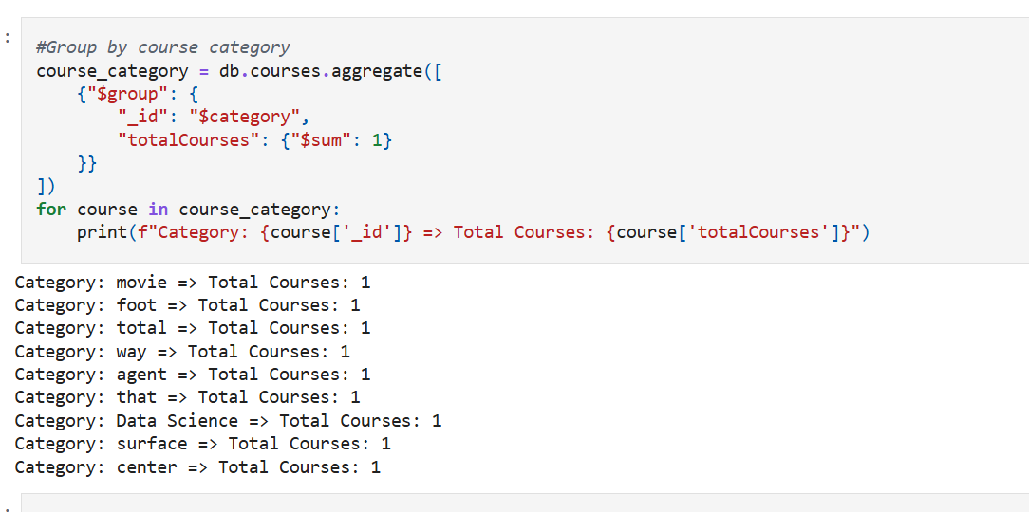
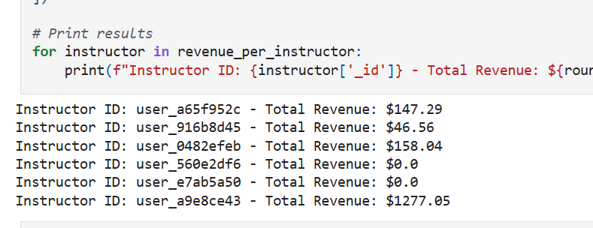
Core Operations (CRUD + Aggregation)
EduHub can perform core operations such as:
Insert, read, update, and soft-delete operations
Aggregation pipelines for:
Course Stats (enrollments, revenue)
Student Performance (average grades, progress)
Instructor Metrics (students taught, earnings
Grouping course by category
Revenue Generated per instructor

Slide 6
Indexing & Performance Boost
Indexing & Performance Boost
Indexes Created:
Users : email
Courses: title, category
Assignment: dueDate
Enrollments: studentId + courseId (composite index)
Results:
Email lookup: 1.2s ➝ 150ms (🔻87% faster)
Assignment date filter: 1.1s ➝ 300ms (🔻73% faster)
Course search: Improved by keyword indexes

Slide 7
Data Validation & Error Handling
Schema rules were created using $jsonSchema. Some of which includes:
Required fields (email, title, etc.)
Email regex validation
Enum constraints (role, level)
PyMongo try-except blocks was used for
Duplicate key errors
Invalid data types
Missing fields

Slide 8
Key Challenges & Solutions
Schema enforcement in a NoSQL setup: Used $jsonSchema validation in MongoDB collections and enforced data integrity during insertions using PyMongo checks.
Performance tradeoffs with text indexes: Optimized by indexing only necessary fields (e.g., title, tags) to avoid unnecessary performance costs.
Relational integrity without joins: Maintained consistency using manual referencing (userId, courseId) and structured aggregation queries instead of joins.
Handling common data errors: Implemented try-except blocks in PyMongo to gracefully manage duplicate keys, invalid inserts, and missing fields.
Lessons Learned / Skills Demonstrated
MongoDB schema design and validation rules
Query optimization and indexing strategy using .explain()
Aggregation pipelines for analytics and reporting
Error handling and defensive programming with PyMongo
Real-world NoSQL database architecture and deployment readiness

Slide 9
Project Summary
"EduHub" is a complete MongoDB-based backend for an e-learning platform, designed to demonstrate the following:
End-to-end CRUD functionality across six interconnected collections
Realistic sample data and relationship modeling
Aggregation pipelines for insights on enrollments, performance, and revenue
Query performance optimization through proper indexing
Schema validation and error management for data consistency
Repository
GitHub Repository: https://github.com/AyoniTemmy/mongodb-eduhub-project.git

Slide 10
Thank You

